Slide 1






NBA champion predict & salary MP predict
113598065 王丞頤
113598078 廖宥霖

Slide 2



Agenda
MOTIVATION DATA PRE-PROCESSING MODEL TRAIN EXPERIMENT CONCLUSION
訣竅：使用連結前往你簡報中的不同頁面。
方法：選取文字，按一下工具列上的連結符號，然後選取簡報中你想連結的頁面。

Slide 3

Motivation:
IN THE NBA, PLAYER PERFORMANCE, SALARY, AND PLAYING TIME ARE KEY INDICATORS OF A TEAM'S SUCCESS. ANALYZING THEIR RELATIONSHIPS HELPS UNDERSTAND HOW THESE FACTORS IMPACT TEAM RESULTS AND PLAYOFF PERFORMANCE. ADDITIONALLY, PREDICTING THE NBA CHAMPION USING REGULAR-SEASON DATA PROVIDES VALUABLE INSIGHTS FOR TEAMS TO OPTIMIZE STRATEGY AND IMPROVE THEIR CHANCES OF WINNING.

Slide 4
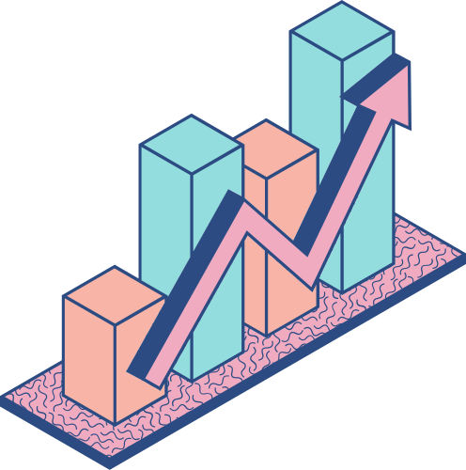
Data Pre-processing

Slide 5

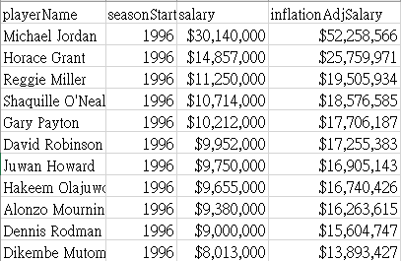
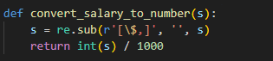
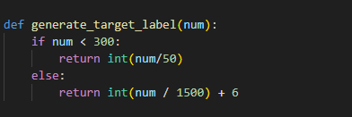
Original Dataset
salaries.csv
salaries processing code

Slide 6
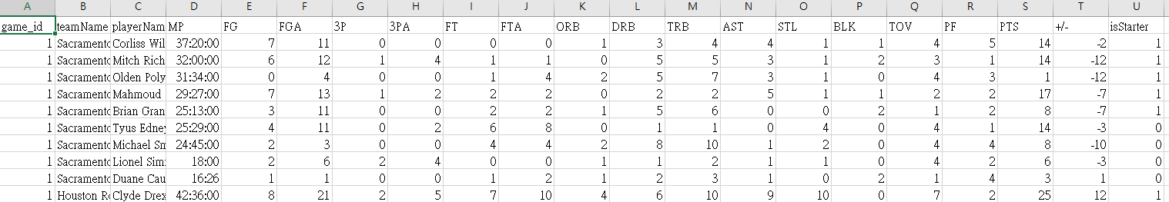
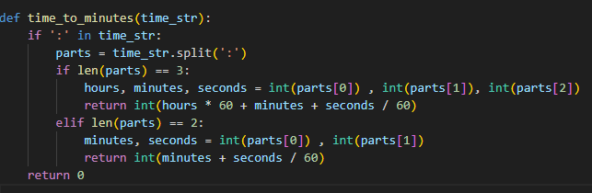
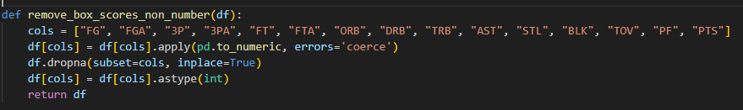
boxscore.csv
boxscore processing code

Slide 7
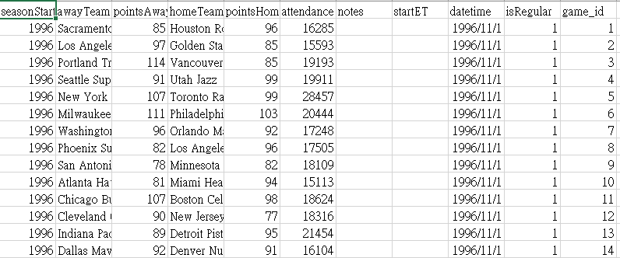
games.csv

Slide 8
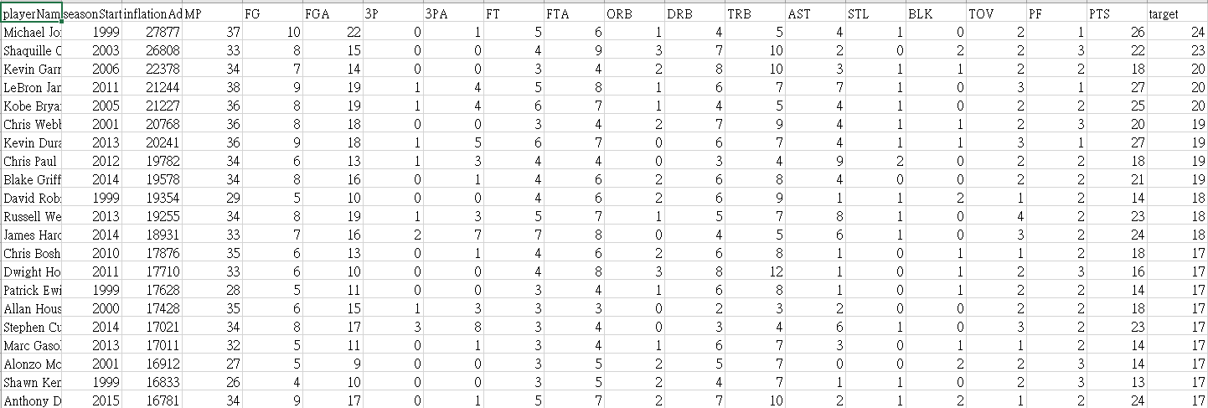
CLEANING DATA

Slide 9
MODEL TRAIN

Slide 10
Model List
SVC XGBOOST KNN Decision-Tree Random Forest Transformer Tab – Transformer DNN (Reference Paper model)

Slide 11
MP & Salary prediction

Slide 12
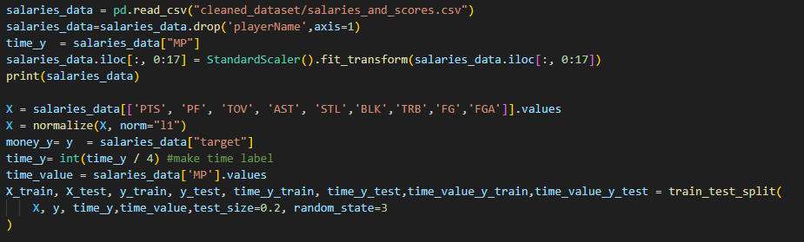
Steps1 : Data preprocessing -> train & test

Slide 13
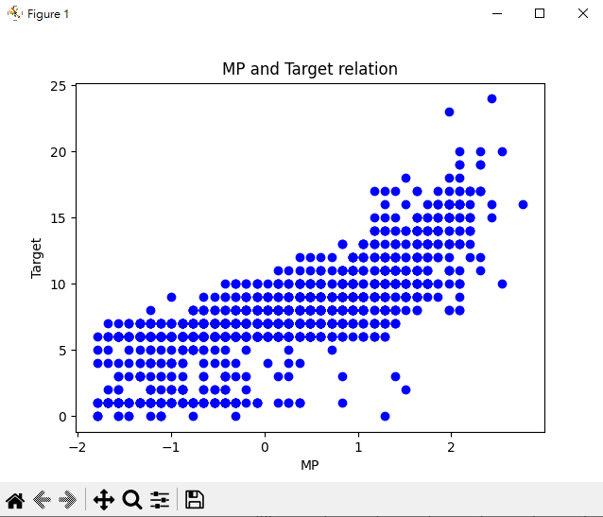
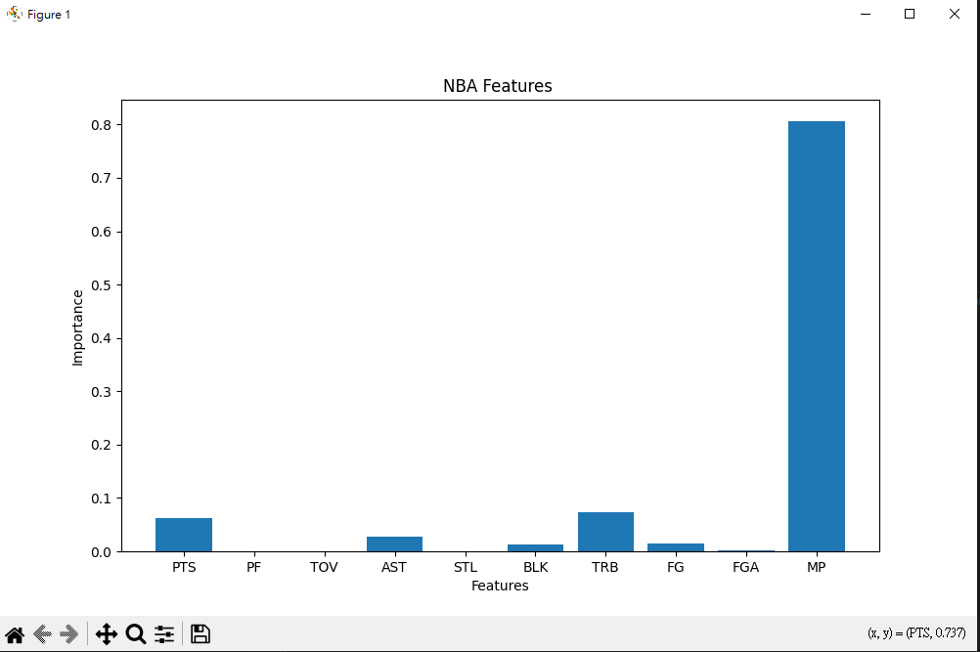
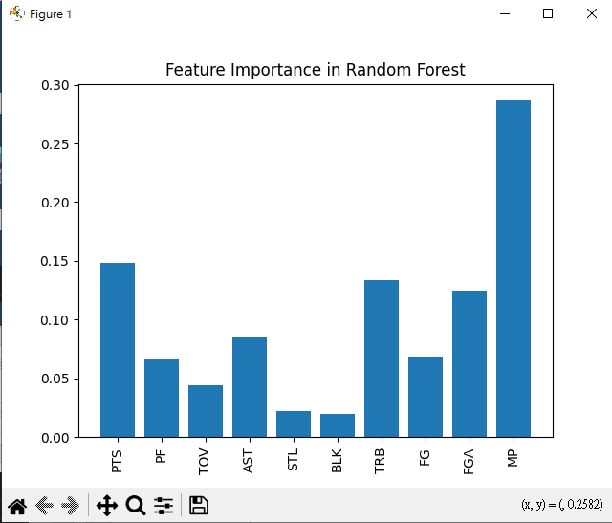
Feature Importance

Slide 14
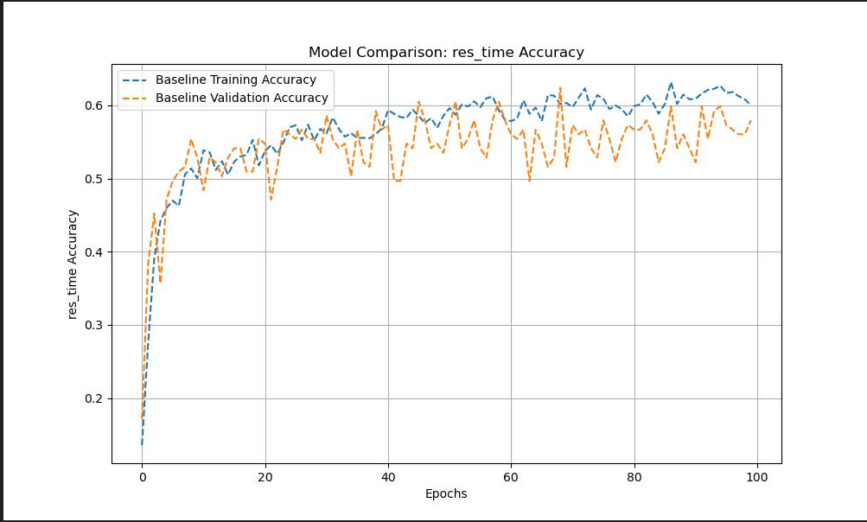
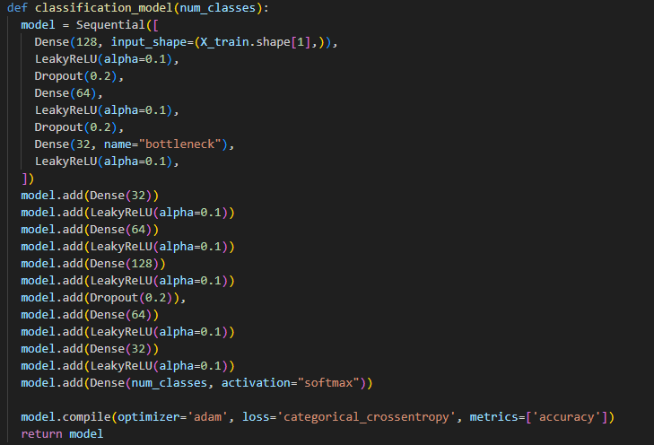
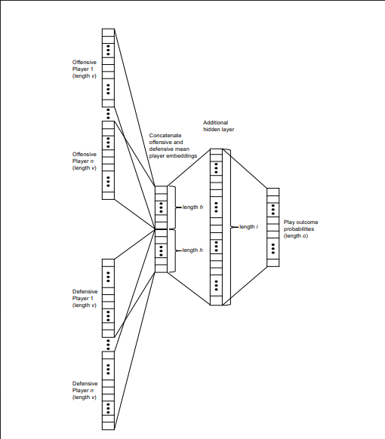
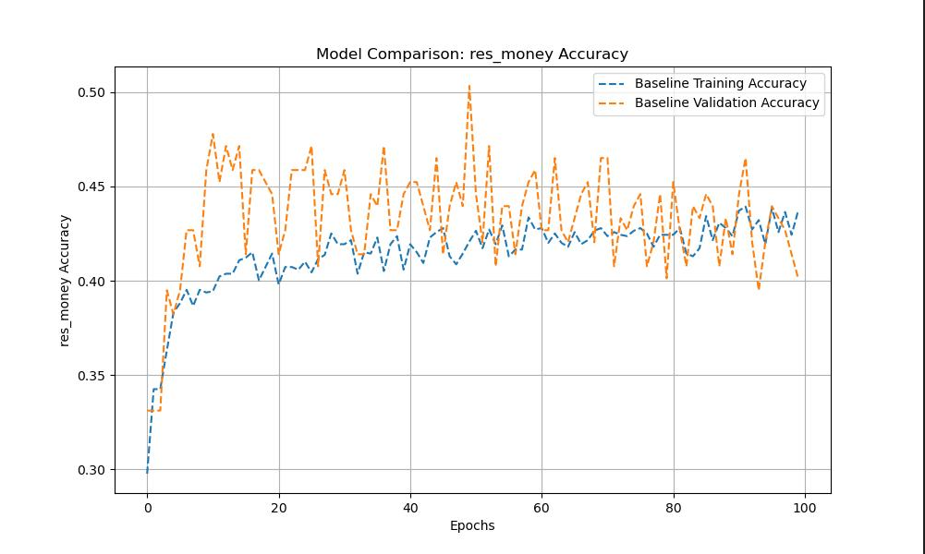
Steps2 : Model train
DNN Model (AutoEncoder)

Slide 15
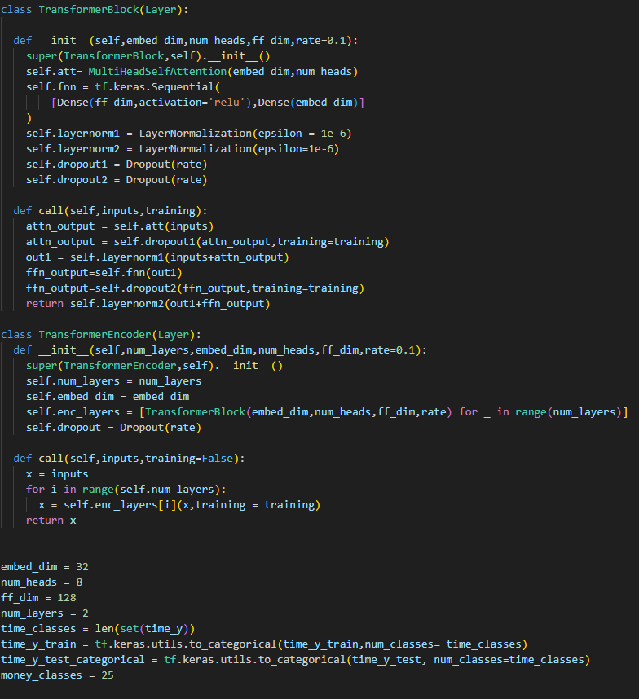
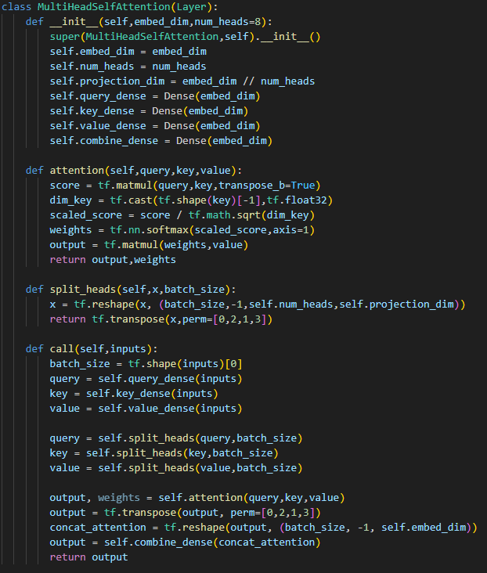
Transformer Model

Slide 16
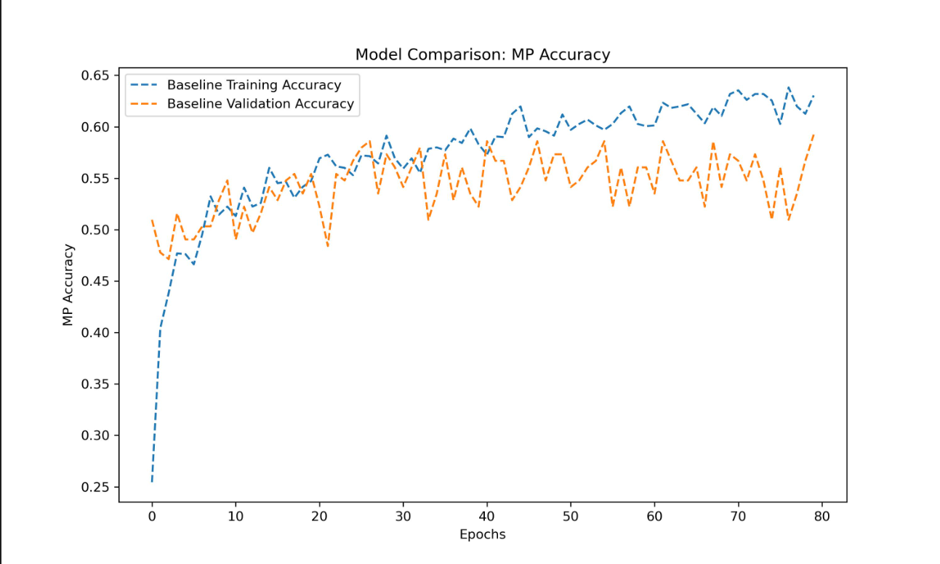
Transformer Model result

Slide 17
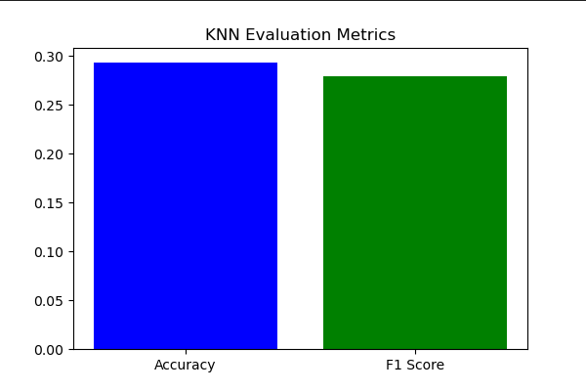
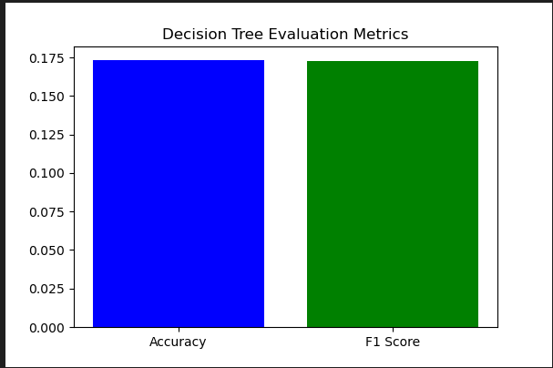
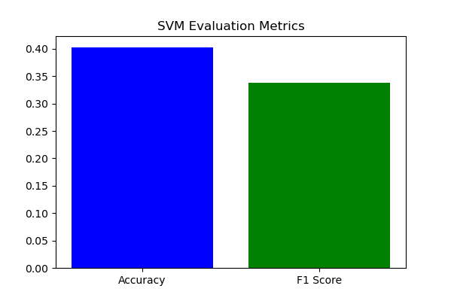
KNN Decision-Tree SVC

Slide 18
Model Experient Result
DNN Model (AutoEncoder)
0.601
0.585
Transformer + flatten + dense
0.63
0.601
Tab- transformer
0.65
0.6447
KNN
0.278
0.255
SVC
0.40
0.35
Decision Tree Classifier
0.175
0.14

Slide 19
Champion Prediction

Slide 20
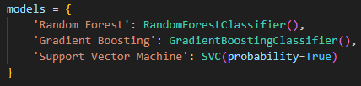
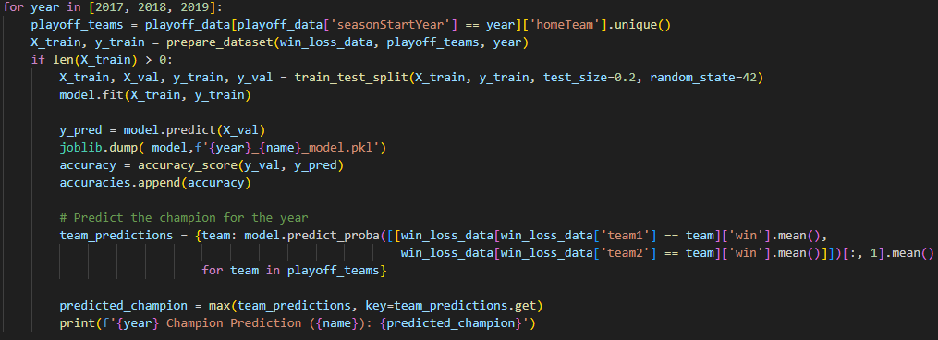
Model train

Slide 21
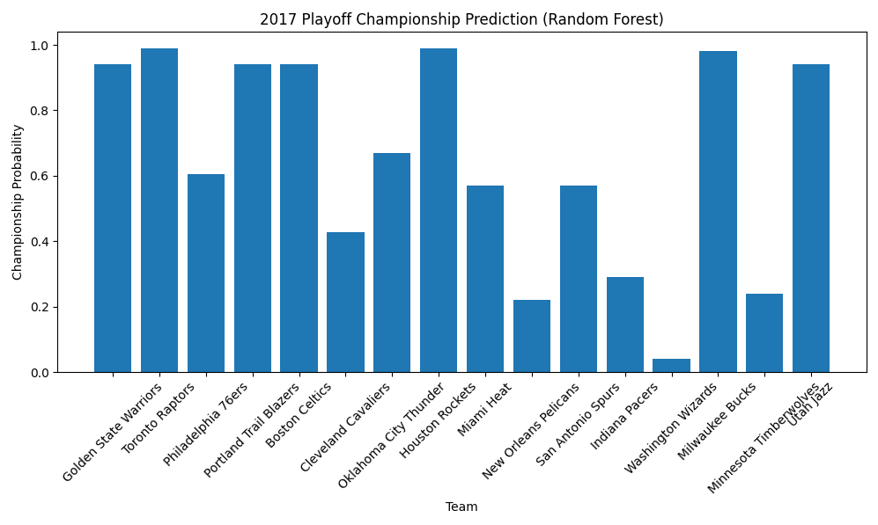
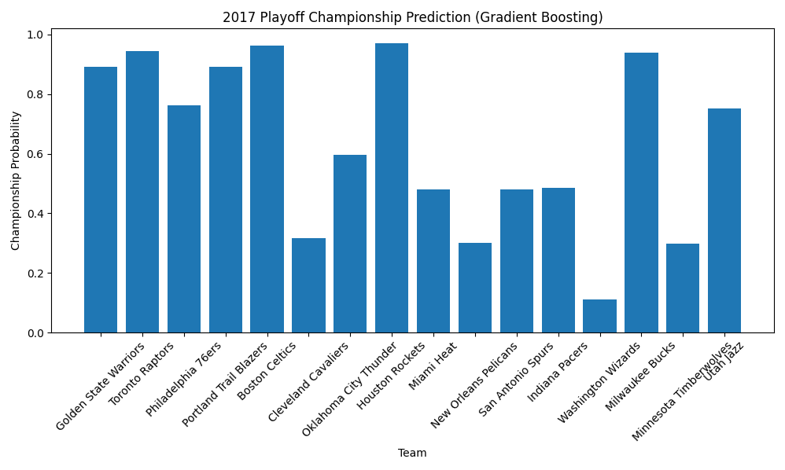
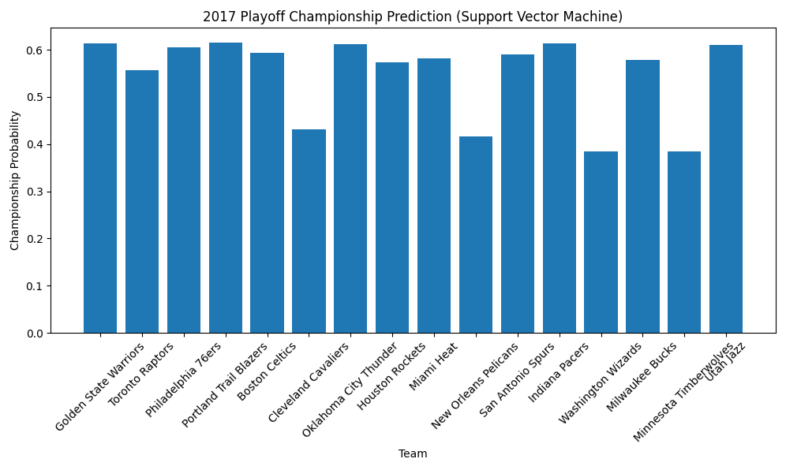
2017 Champion Prediction
Random Forest: Golden State Warriors
Gradient Boosting: Golden State Warriors
Support Vector Machine: Washington Wizards
Champion: Golden State Warriors

Slide 22
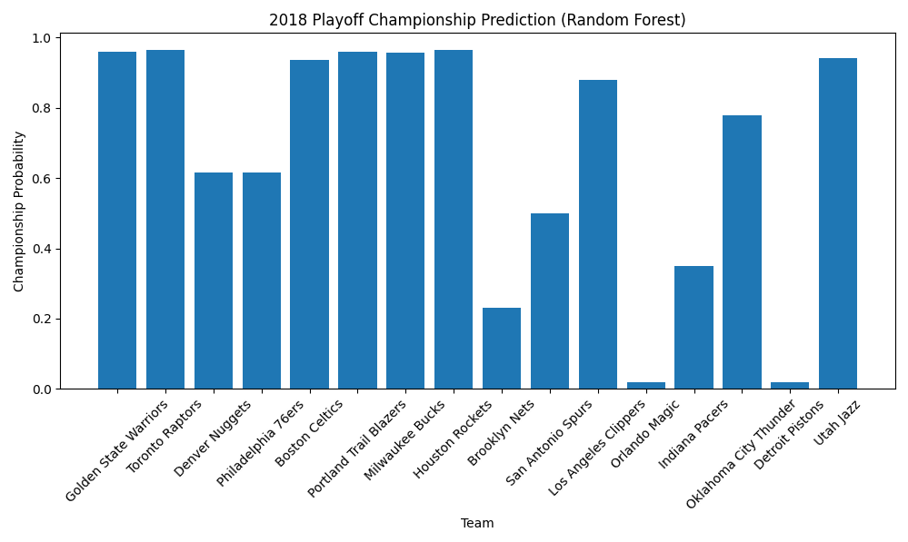
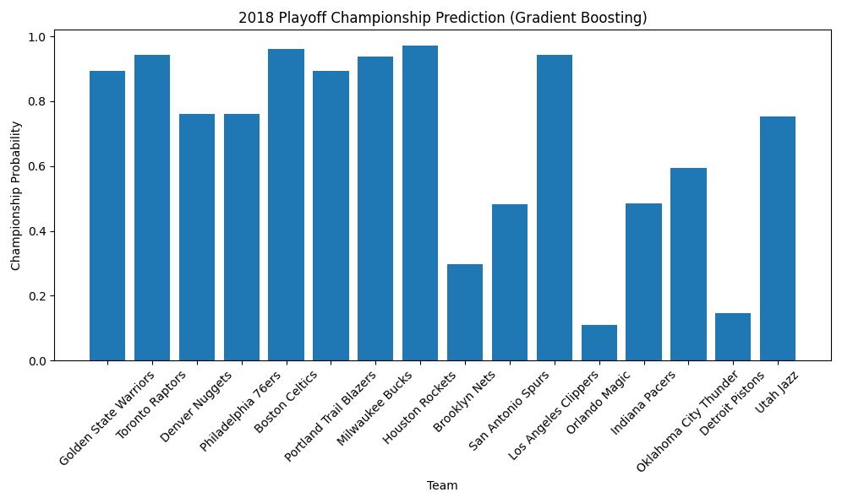
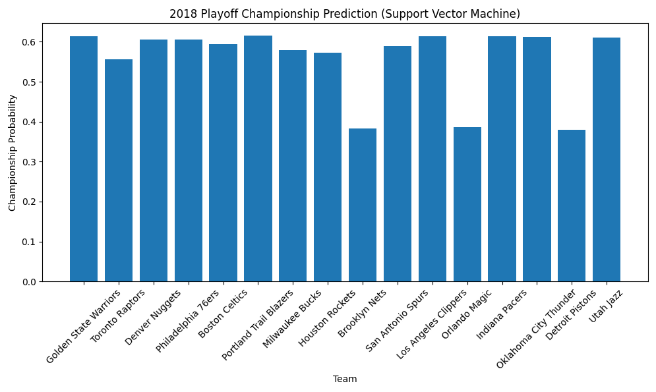
2018 Champion Prediction
Random Forest: Utah Jazz
Gradient Boosting: Toronto Raptors
Support Vector Machine: Denver Nuggets
Champion: Toronto Raptors

Slide 23
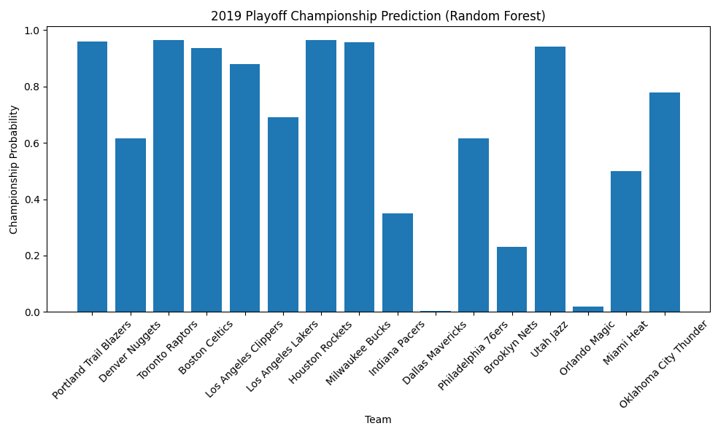
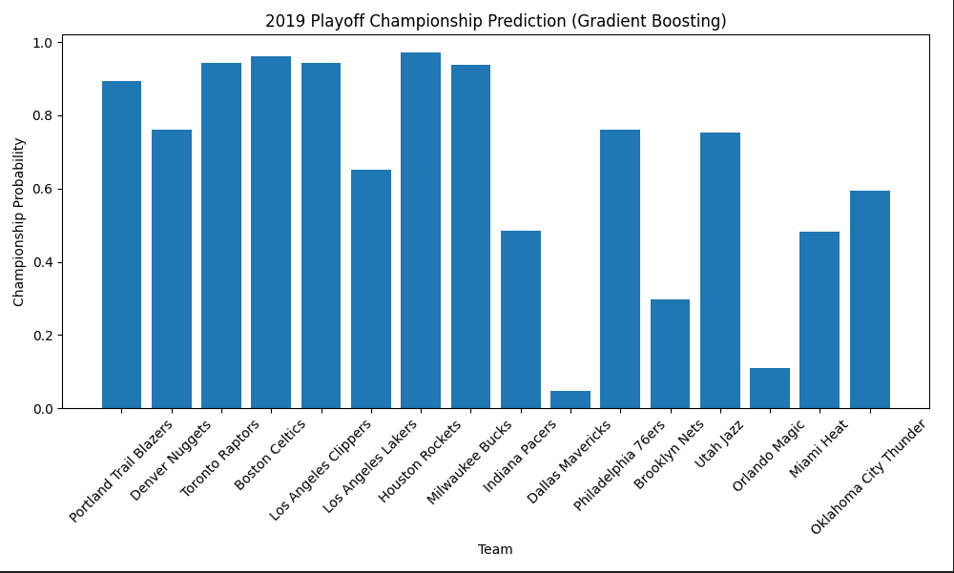
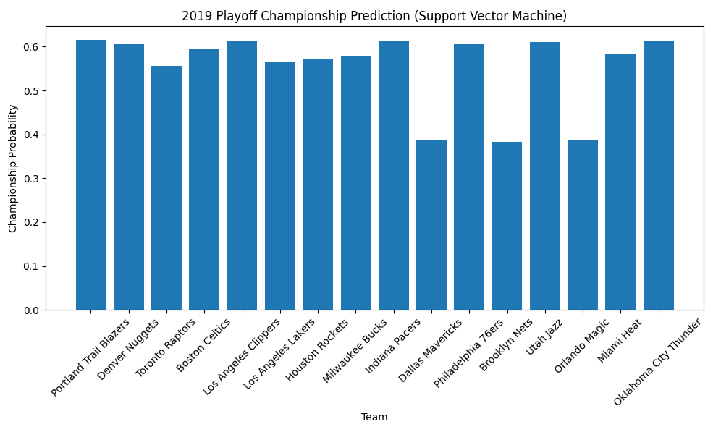
2019 Champion Prediction
Random Forest: Toronto Raptors
Gradient Boosting: Houston Rockets
Support Vector Machine: Portland Trail Blazers
Champion: Los Angeles Lakers

Slide 24
Conclusion
Data Preprocessing and Feature Importance:
Thorough data cleaning and feature extraction provided a solid foundation for model training.
Feature importance analysis effectively identified the most influential variables.
Model Comparison and Experimental Results:
Salary Prediction: The Transformer model and Tab-Transformer model performed the best, achieving accuracy scores of 0.65 and 0.6447, respectively.
Champion Prediction: Ensemble learning methods, such as Random Forest and Gradient Boosting, consistently predicted champions across different years, demonstrating robustness and efficiency.
Model Highlights and Application Potential:
The combination of AutoEncoder with deep neural networks (DNN) and Transformer architectures showcased superiority in handling high-dimensional data.
Traditional machine learning models (e.g., KNN and SVC) showed limitations on certain datasets but still provided valuable benchmarks.
Champion Prediction Results:
Despite variations among models, the overall predictions aligned well with actual champions, particularly the 2019 champion prediction, which highlighted the models' comprehensive performance.
Notes:
結論
在本研究中，我們探討了多種模型與方法，成功預測了 NBA 球員薪資和賽季冠軍結果。以下是主要發現與成果：
數據預處理與特徵重要性分析：
經過細緻的數據清理和特徵提取，為模型訓練提供了堅實基礎。
特徵的重要性分析有效幫助我們選擇了最具影響力的變數。
多模型比較與實驗結果：
薪資預測：Transformer 模型與 Tab-Transformer 模型表現最佳，分別達到了 0.65 和 0.6447 的準確率。
冠軍預測：集成學習方法（隨機森林和梯度提升）在不同年份中多次準確預測冠軍隊伍，展示了其穩健性和高效性。
模型亮點與應用潛力：
AutoEncoder 結合深度神經網絡（DNN）和 Transformer 架構，顯示了在高維數據處理中的優越性。
傳統機器學習模型（如 KNN 和 SVC）在部分數據集上的表現存在局限，但仍具有參考價值。
冠軍預測結果：
儘管不同模型間存在差異，但整體預測結果與實際冠軍相符，特別是 2019 年的冠軍預測顯示了模型的綜合效能。
未來，我們建議進一步結合即時數據和更先進的深度學習技術，以提升預測準確率和實用性。同時，探索更細化的特徵工程方法，將有助於模型性能的進一步提升。

